Slide 1
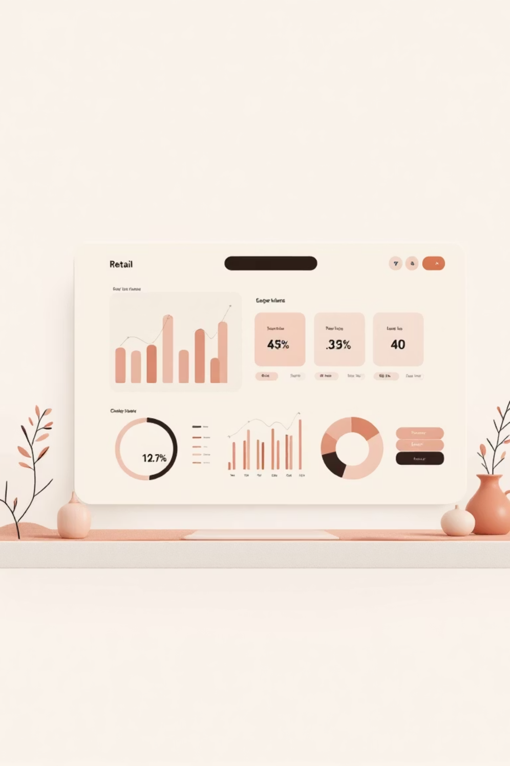
Customer Shopping Behavior Analysis
Uncovering insights from 3,900 purchases to guide strategic business decisions through data-driven analysis of spending patterns, customer segments, and product preferences.

Slide 2

DATASET OVERVIEW
The Foundation: Our Data
3,900
18
37
Total Purchases
Data Features
Missing Values
Transactions analyzed across all categories
Comprehensive attributes tracked
Only in Review Rating column
Key features include customer demographics (Age, Gender, Location, Subscription Status), purchase details (Item, Category, Amount, Season, Size, Color), and shopping behavior (Discounts, Previous Purchases, Frequency, Review Rating, Shipping Type).

Slide 3
PYTHON ANALYSIS
Data Preparation & Cleaning
01
02
03
Data Loading & Exploration
Missing Data Handling
Column Standardization
Imported dataset using pandas, examined structure with df.info() and summary statistics
Imputed Review Rating nulls using median rating per product category
Renamed columns to snake_case for consistency and readability
04
05
Feature Engineering
Database Integration
Created age_group and purchase_frequency_days columns for deeper insights
Connected to MySQL and loaded cleaned data for SQL analysis

Slide 4
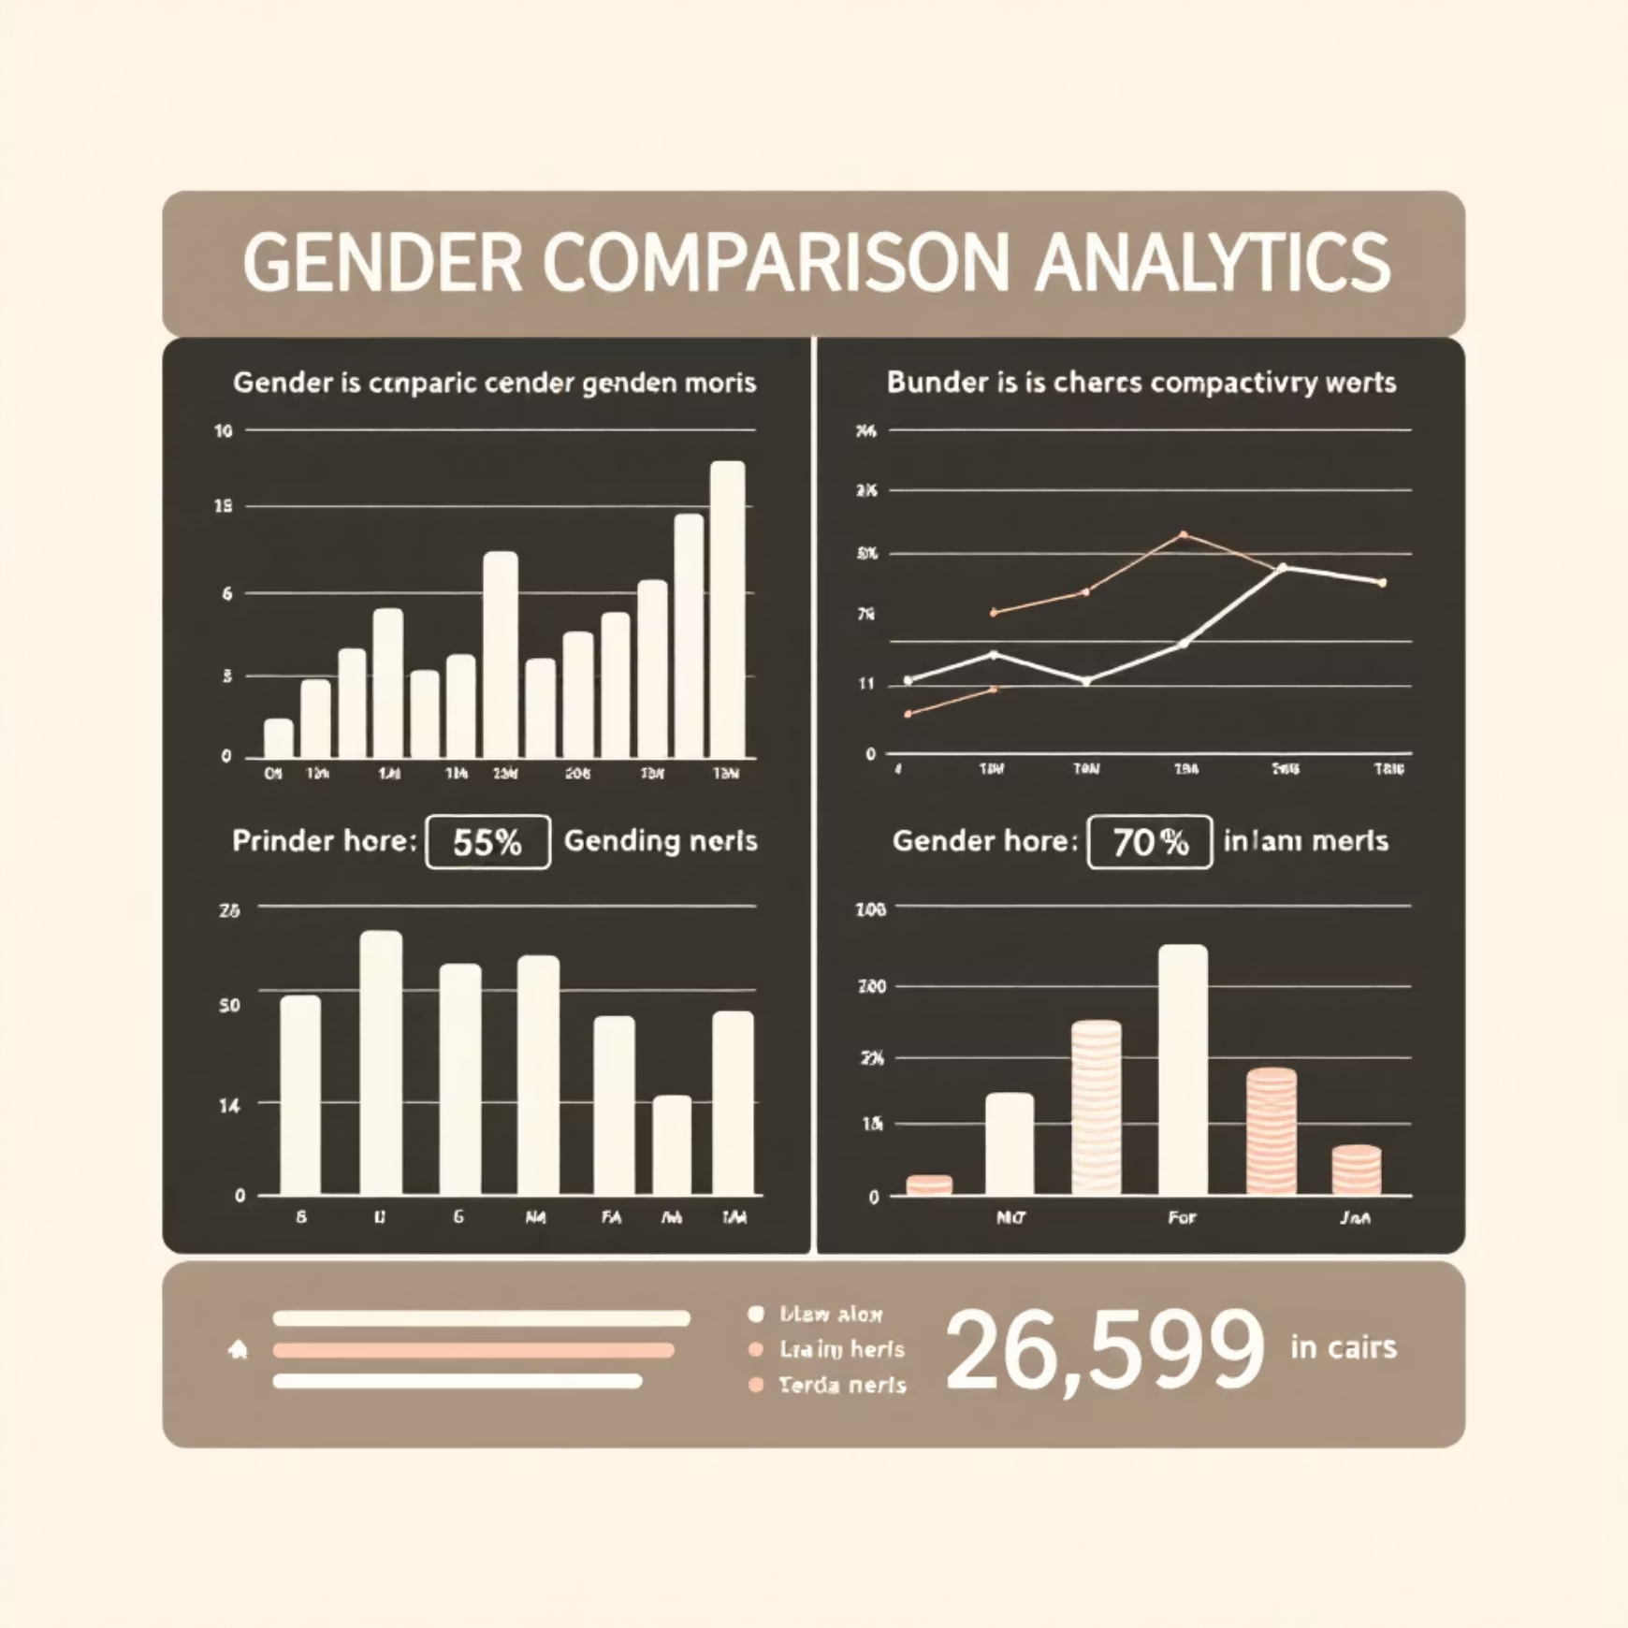
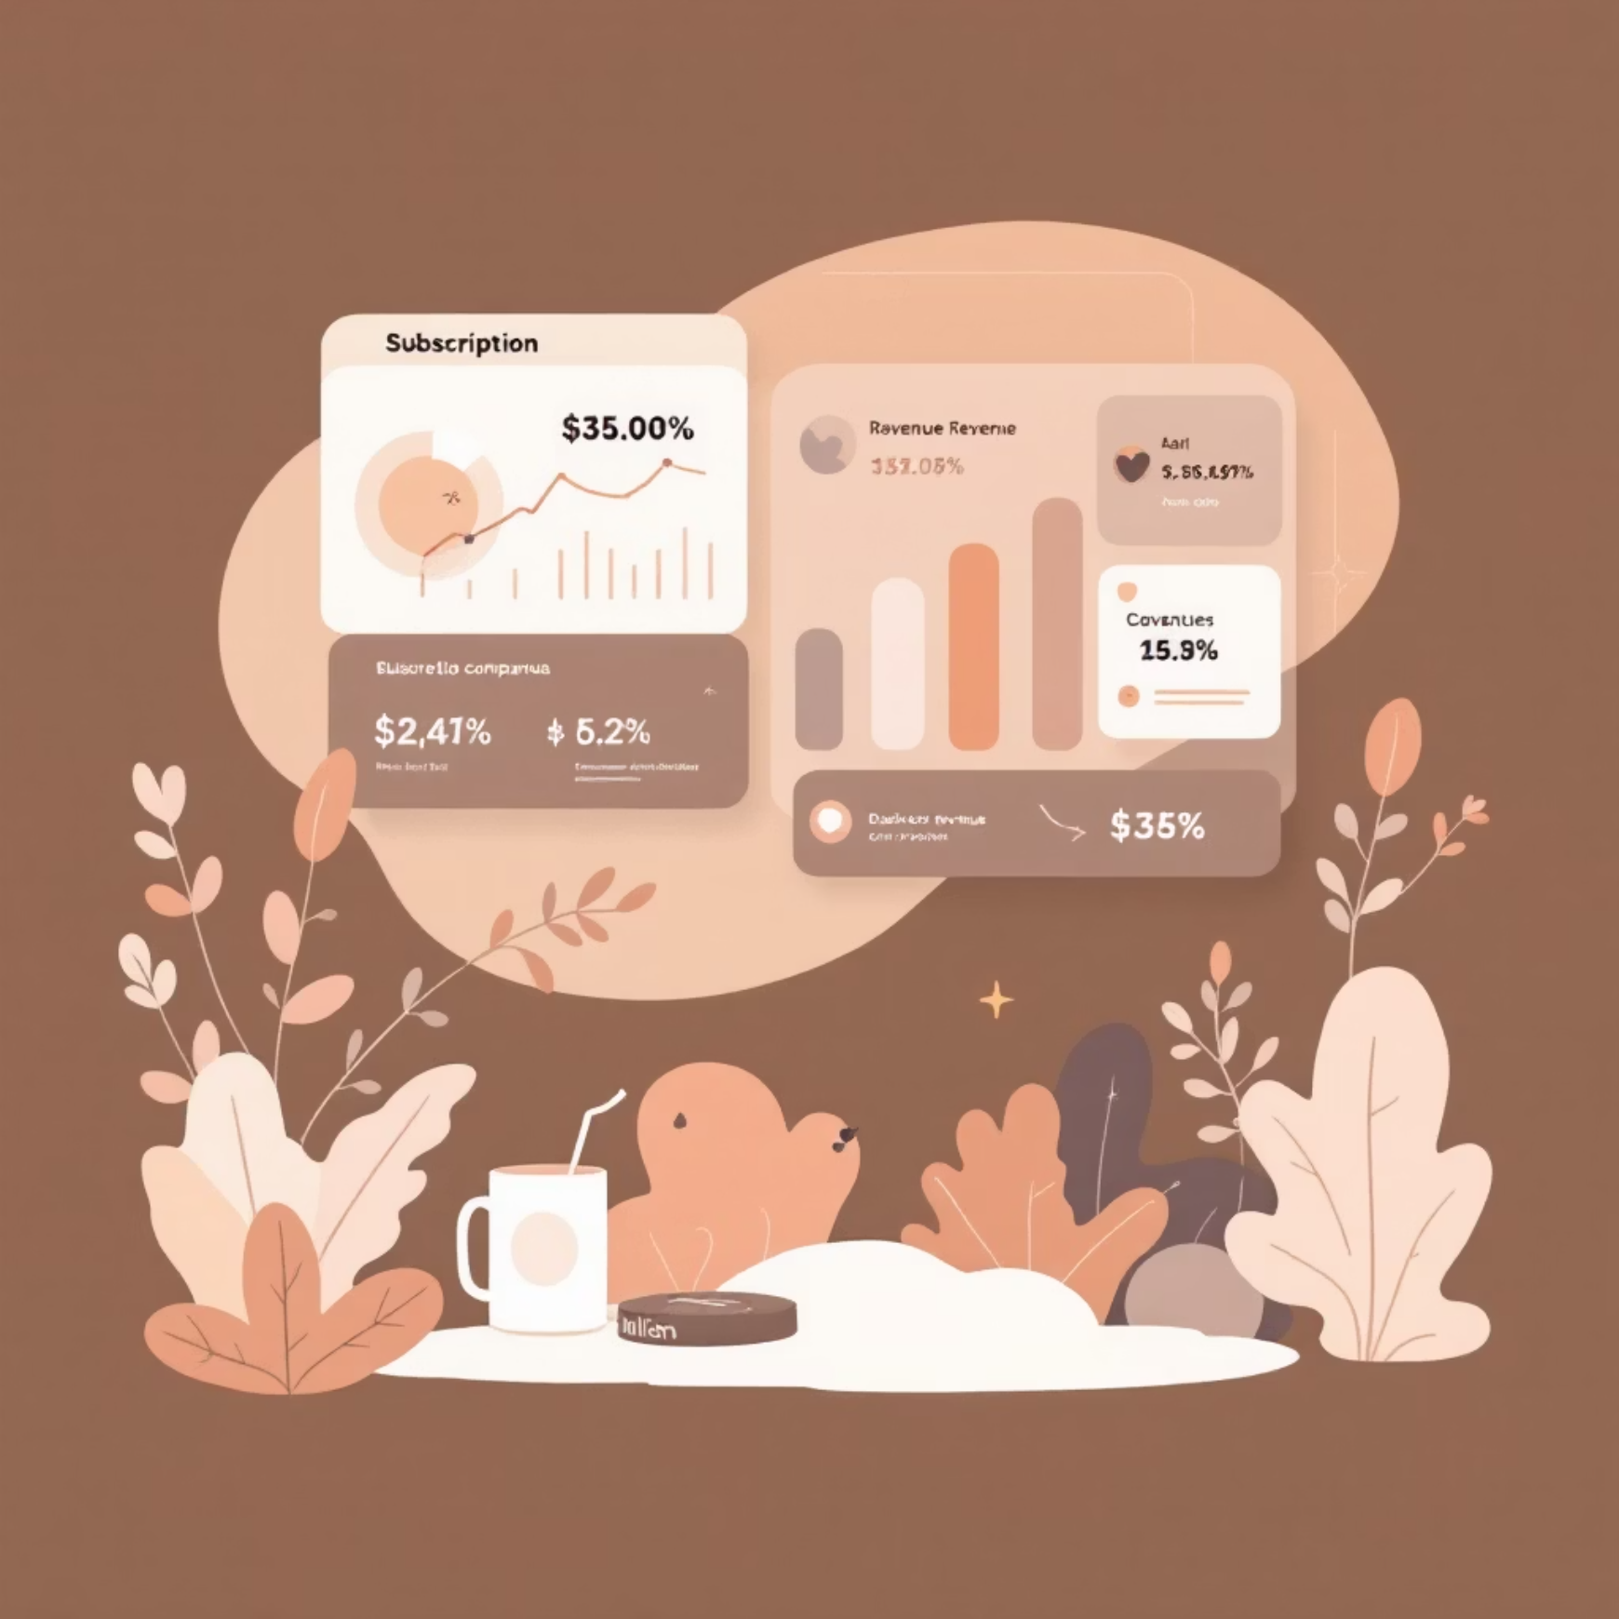
SQL INSIGHTS
Revenue Analysis: Gender & Subscriptions
Revenue by Gender
Subscribers vs Non-Subscribers
Male and female customers show distinct purchasing patterns, with analysis revealing total revenue contribution by gender segment.
Subscription status significantly impacts both average spend and total revenue, highlighting the value of loyalty programs.

Slide 5
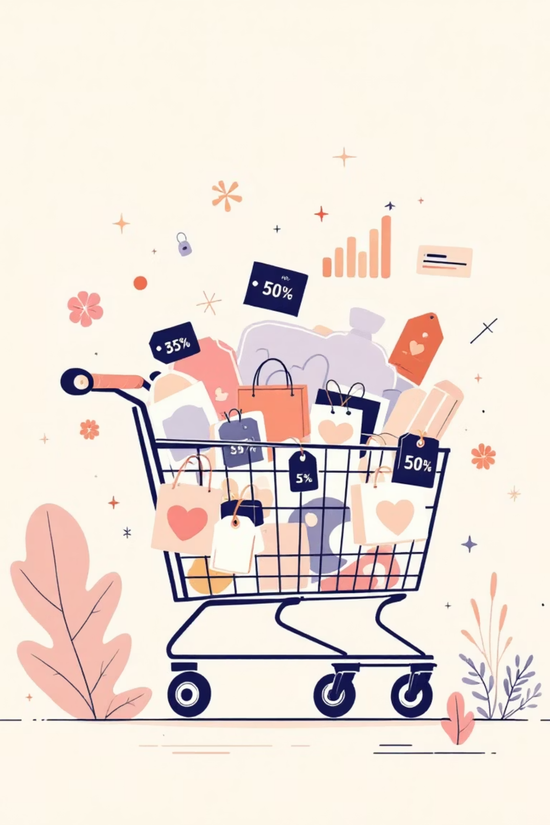
Customer Spending Patterns
High-Spending Discount Users
Shipping Type Comparison
Express shipping users show different average purchase amounts compared to Standard shipping, indicating premium customer behavior.
Identified customers who used discounts but still spent above average purchase amount, revealing price-conscious yet high-value segments.
Discount-Dependent Products
Top 5 products with highest percentage of discounted purchases reveal which items rely most heavily on promotions to drive sales.

Slide 6

PRODUCT PERFORMANCE
Top-Rated & Best-Selling Products
Top 5 Products by Rating
Products with highest average review ratings represent quality benchmarks and customer satisfaction drivers across categories.
Top 3 Products per Category
Most purchased items within each category reveal consumer preferences and guide inventory optimization strategies.

Slide 7



Customer Segmentation Analysis
Loyal
Returning
New
Customers classified into three segments based on purchase history. Analysis reveals that customers with more than 5 purchases show significantly higher subscription rates, demonstrating the connection between repeat buying behavior and loyalty program adoption.

Slide 8
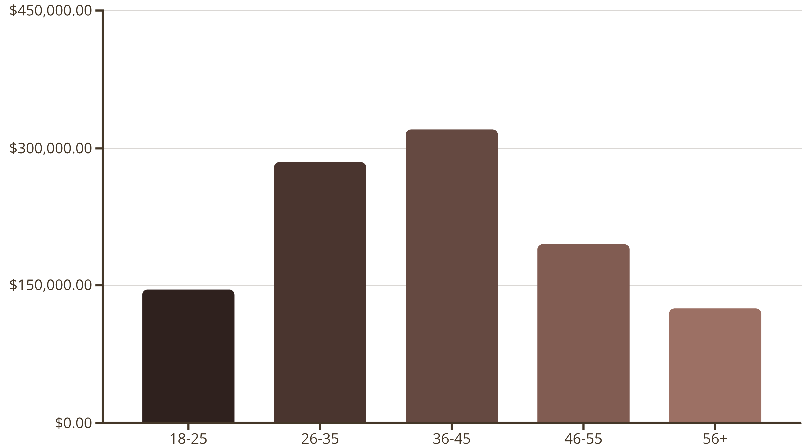
Revenue by Age Group
Total revenue contribution varies significantly across age demographics, revealing which segments drive the most business value.
The 36-45 age group generates the highest revenue, followed closely by 26-35, indicating prime target demographics for marketing campaigns.

Slide 9
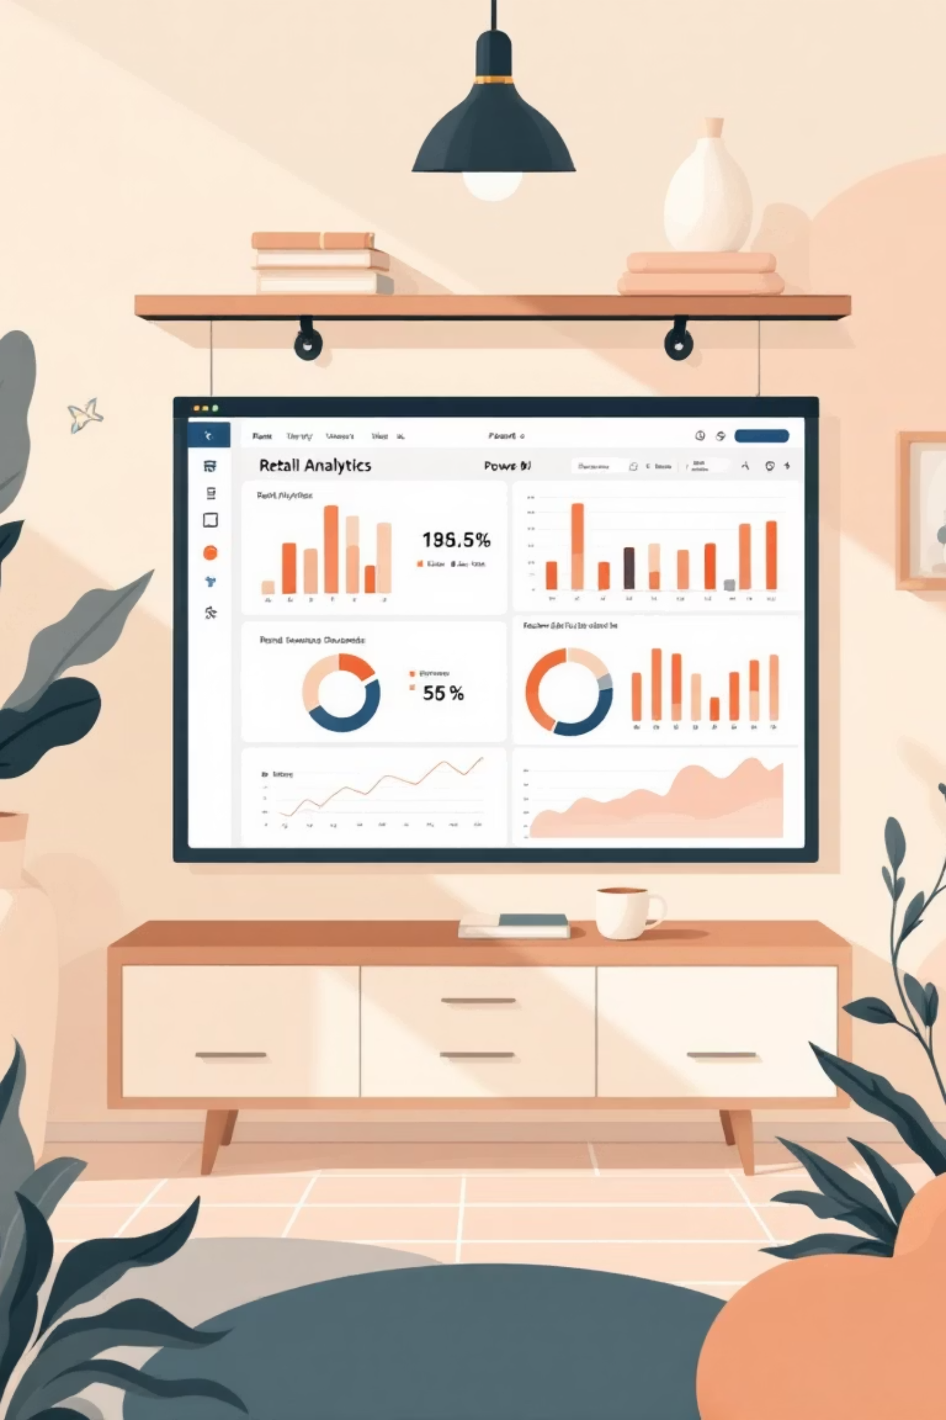
POWER BI
Interactive Dashboard
Comprehensive Power BI dashboard visualizes all key insights interactively, enabling stakeholders to explore customer behavior patterns, revenue trends, and product performance metrics in real-time for data-driven decision making.

Slide 10
STRATEGIC RECOMMENDATIONS
Business Recommendations
Boost Subscriptions
Loyalty Programs
Review Discounts
Promote exclusive benefits for subscribers to increase recurring revenue
Reward repeat buyers to move them into "Loyal" segment
Balance sales boosts with margin control for sustainable growth
Product Positioning
Targeted Marketing
Highlight top-rated and best-selling products in campaigns
Focus on high-revenue age groups and express-shipping users

